Slide 1
INDUSTRIAL SAFETY MANAGEMENT - Unit – I
SAFETY ORGANISATION

Slide 2

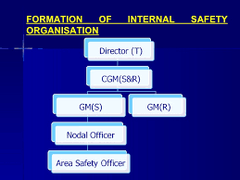
SAFETY ORGANIZATION
Safety organization constitutes a vehicle – of systematic procedures by which interest is created and maintained and all safety activities are correlated and directed
Safety organization is a “clearing house” of information on safety matters
It includes safety committees, safety inspectors, safety meetings that includes the interest, support, direction and participation of the higher executives

Slide 3
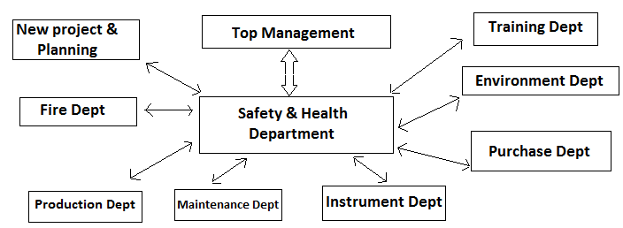
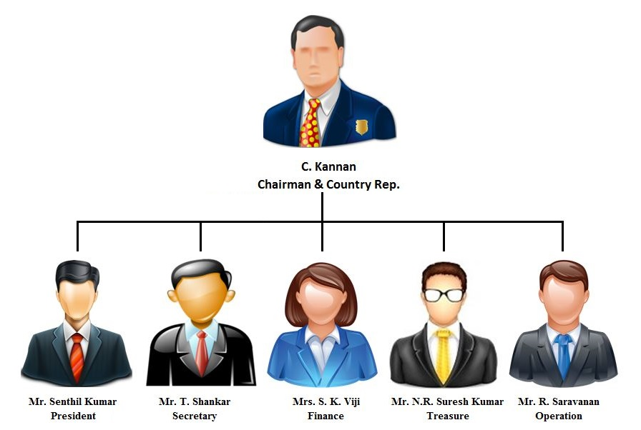
SAFETY ORGANISATION
World Safety Organization, India

Slide 4
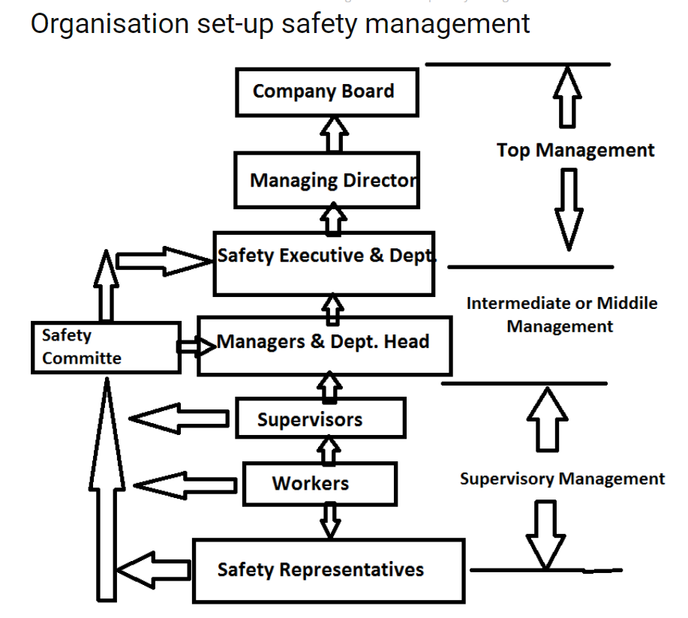

Slide 5
Elements of Safety Organisation
Safety Policy
Safety Culture
Safety Planning
Safety Promotion
Safety Inspection
Safety Rules
Safety Responsibility
Safety Supervision
Safety training
Safety Investigation and analysis

Slide 6

SAFETY POLICIES
Safety Policies are those principles and rules of action which guide an organization to achieve its objectives with due regard for its business ideals. (when accident prevention is the objective, the setting down of the guiding principles and rules provide a foundation upon the safety organisation)
Policies should not be confused with Procedures. Policies are designed to guide us in what to do; Procedures inform us how to do it
Policies guide to action in decision making

Slide 7

Sound safety policies requirement:
Promote intelligent co-operation at all levels
Prevent deviation from accepted courses of action
Provide a network for the intelligent exercise of initiative
Produce a foundation for co-ordination at various levels
Present a clear expression of management’s objectives and intentions
Areas should be covered in safety policy
Management’s intent - what management want?
Scope of activities - does policy pertain only job safety? Any other
Responsibilities - who is responsible?
Accountability - where and how it fixed?
Safety committees - what the committee will do?
Authority - who has the authority?
Standards what rules will the industry abide?

Slide 8
Safety policy statement
Safety policy statement is the foundation of the safety programme
Safety policy statement must be perceived as company policy, not the safety person’s policy
Objectives & Philosophy behind safety commitment
The safety and health of all employees is our first priority
The only safety and health performance is one that prevents injury and accidents
Safety and health are integral part of production and all other business functions that cannot be separated/bypassed
Safety and health are a responsibility that must be shared equally and without exception by everyone within the organization
Supervisors and Management will be held accountable for the safety and health of the personnel for whom they are responsible

Slide 9
Developing Safety policy will include
Write and announce the policy regarding the control of hazards for which organisation has a responsibility
Appoint a safety director
Analyse the operational record of injuries, property damage and work illness
Appraise the scope and seriousness of operational hazards
Select, organise and schedule communication methods like safety training, safety maintenance
Establish a periodic review scheduled for auditing
Determine long-range objectives and short term goals for the programme

Slide 10
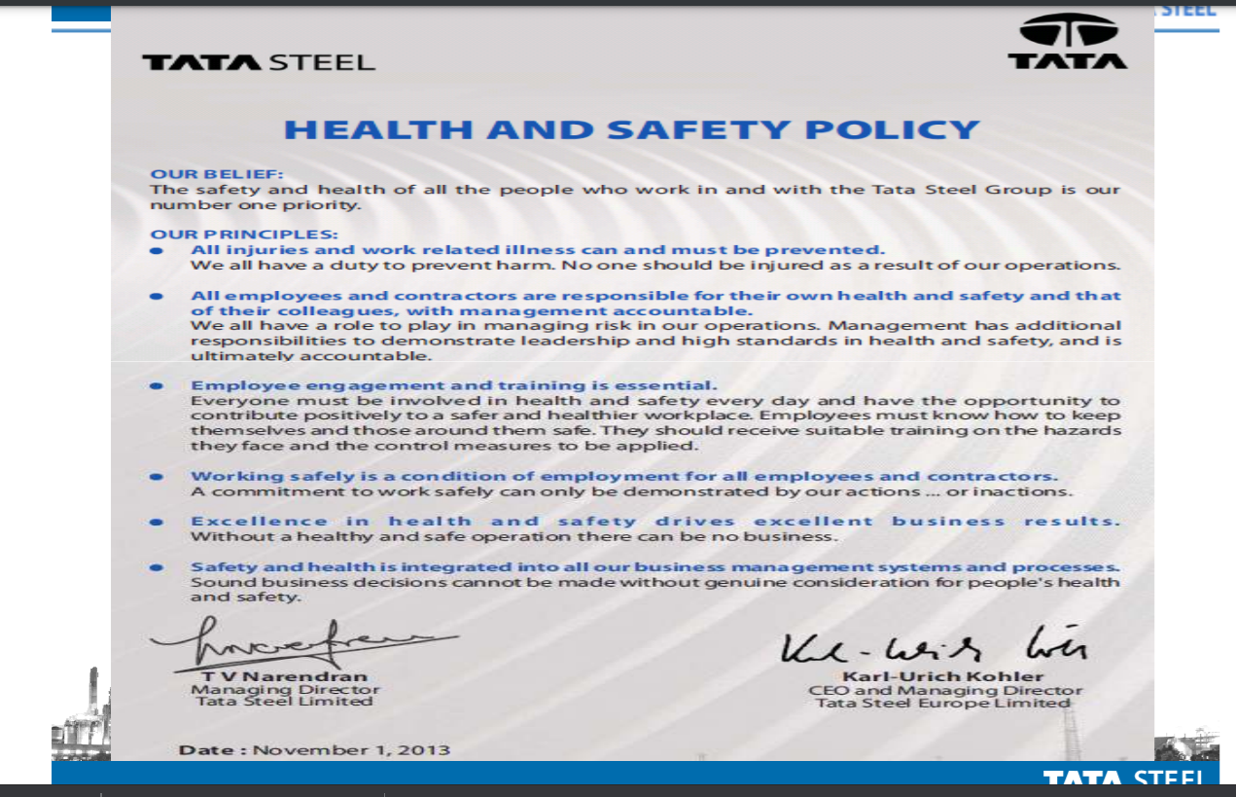

Slide 11
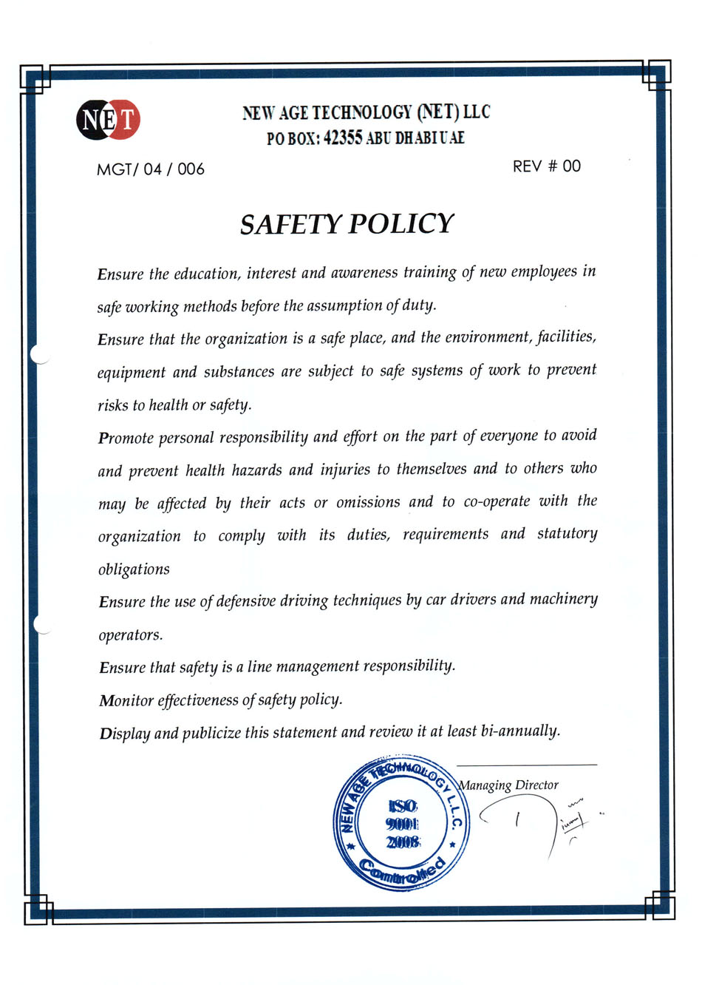

Slide 12
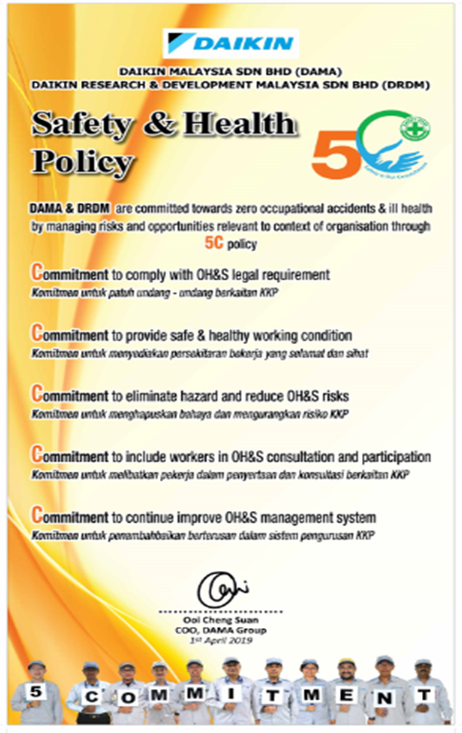

Slide 13



Safety culture is the attitude, beliefs, perceptions and values that employees share in relation to safety in the workplace.
Safety culture is a part of organizational culture, and has been described by the phrase "the way we do things around here“
A good safety culture can be promoted by senior management commitment to safety, realistic practices for handling hazards, continuous organisational learning, and care and concern for hazards shared across the workforce
Coal mine colarado

Slide 14

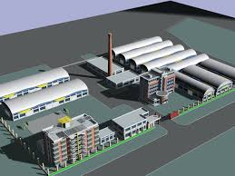
Safety Planning
Good planning is an essential in safety as it is in production
It is essential that safety considerations be borne in mind at the time of actual planning of the building
For a new factory
Site
Facilities for handling and storing materials equipments, lighting, heating, ventilation, lifts, pressure vessels, boilers, electrical installations

Slide 15
Principles in Planning for safe and efficient production
Keep the handling of materials and articles to the minimum
Provide adequate space for machinery and equipment
Provide safe working surfaces on floors, stairs, platforms
Provide for the safety of maintenance and repair personnel
Provide safe transport facilities
Provide adequate means of escape in case of fire
Isolate dangerous processes, such as spray-painting and processes with high fire or explosion risks
If possible only buy machines with built in safety devices

Slide 16
Principles of planning
Keep the handling of materials and articles to minimum
Provide adequate space for machinery and equipment
Provide safe working surfaces (floors, stairs, platforms,etc.)
Provide safe transport facilities
Provide adequate safe exit
Isolate dangerous processes

Slide 17




Safety Promotion
It is necessary to motivate employees to perform their work safely
Safety promotion is persuasion through motivation
An effective safety programme must be persuasive; it must provide a stimulus to which employees will respond
Safety promotion = combination of
Training and Knowledge sharing
Safety Promotion posters

Slide 18
SAFETY INSPECTION

Slide 19

Safety Inspection
Workplace investigations are undertaken with the aim of identifying hazards and promoting remedial action
The safety inspection should check maintenance standards, employee involvement, working practices, fire precautions and adherence to safe working procedures
Elements of safety inspection procedure:
Identification of possible hazards
Assessment of potential losses from these hazards
Selection of control measures designed to eliminate or reduce the hazards
Implementation of control measures with the organization
Monitoring the effectiveness of measures
Reviewing at frequent intervals

Slide 20

Safety inspection helps safety management programme in many ways
Regular inspections at shop floor level cannot escape the notice of the employees – this creates management’s interest in the safety and welfare of employees and thus contributes to better shop floor relations
Safety inspection brings to light the areas where waste can be decreased, processes can be improved and productivity increased
Safety inspection result in contact with employees which usually result in better understanding and mutual help

Slide 21
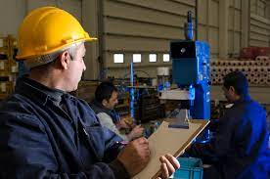
Plant Inspection list
Housekeeping
Material handling methods
Adequate of aisle space and working place
Point-of-operation guards
Maintanence
Handtools
Ladders, portable steps,etc
Hand trucks, power trucks, wheel barrows, etc
Floors, platforms, stairs
Lighting
Electrical equipment, extension cords
Elevators
Eye protection
Personal protective equipment
Any other explosion hazards
Inspection of chain, cables, slings
Exits
Yards, roofs and roadways
R.P. Blake recommends the use of checklists of items while carrying plant inspection

Slide 22

Safety rules
Safety rules are codes of conduct designed for the purpose of avoiding injury and property damage
Following guidelines are to be observed while preparing safety rules
Safety rules must be clear and easily understood
Keep the number of general rules to a minimum
Formulate only those rules that are currently required
Stipulate only those rules that can be strictly enforced

Slide 23

Safety rules should have common characteristics
Purpose – It establishes credibility and can be a promotional tool for employee acceptance
Scope – who is covered by the rule? What areas of the facility will be covered when the rule is in effect
Requirement – each requirement must be written clearly and using words and terms that are easily understood
Date – the date of the rule was issued and revisions are important
Signature – signature of the person authorizing the rule adds credibility

Slide 24
Safety Responsibility
It includes designing of processes, machines, jigs and fixtures , until it is clear that operation is safe to the worker and will not constitute any hazard to other employees
Machines and processes should be planned, arranged or guarded as to preclude the possibility of injury
Safety responsibilities also include product and process research, accounting department, purchasing
Each worker has a safety responsibility. Responsibility must be clear to all
Employees
Supervisors
Top management
Union

Slide 25
A safe place to work and safe work procedures are management’s responsibility
First – line Supervisor | Maintaining day today safety requirements in every organisation
Safety minded supervisor | Can make pretty good safety record even if there are other constraints
Supervisors | Must accept responsibility for all safety failures

Slide 26

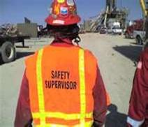
Safety Supervision
Supervision of safety performance throughout the organizational hierarchy is a paramount requirement
Production and quality is depends on supervisor’s competent scheduling, training and leadership
Supervisor is vital in all accident prevention
Best supervisor looks into his men, machines and materials for having qualitative safe production

Slide 27
Areas should be covered in special supervisory safety training courses
Accident causes
How to train employees to work safely
Accident investigation
Job safety analysis
How to conduct a safety meeting
Facility inspections
Competent supervisor can train his own employees much better than outside trainer

Slide 28
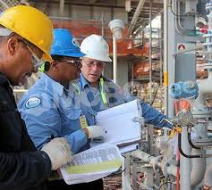
Supervisor has the following principle responsibilities
Establishing work methods for orderly as well as safe production
Giving job instructions
Assigning jobs to people
Supervising people at work
Maintaining equipment and the workplace
Supervisors should show their subordinates how to do the work safely and ensure that they have the knowledge and skills to do it exactly

Slide 29

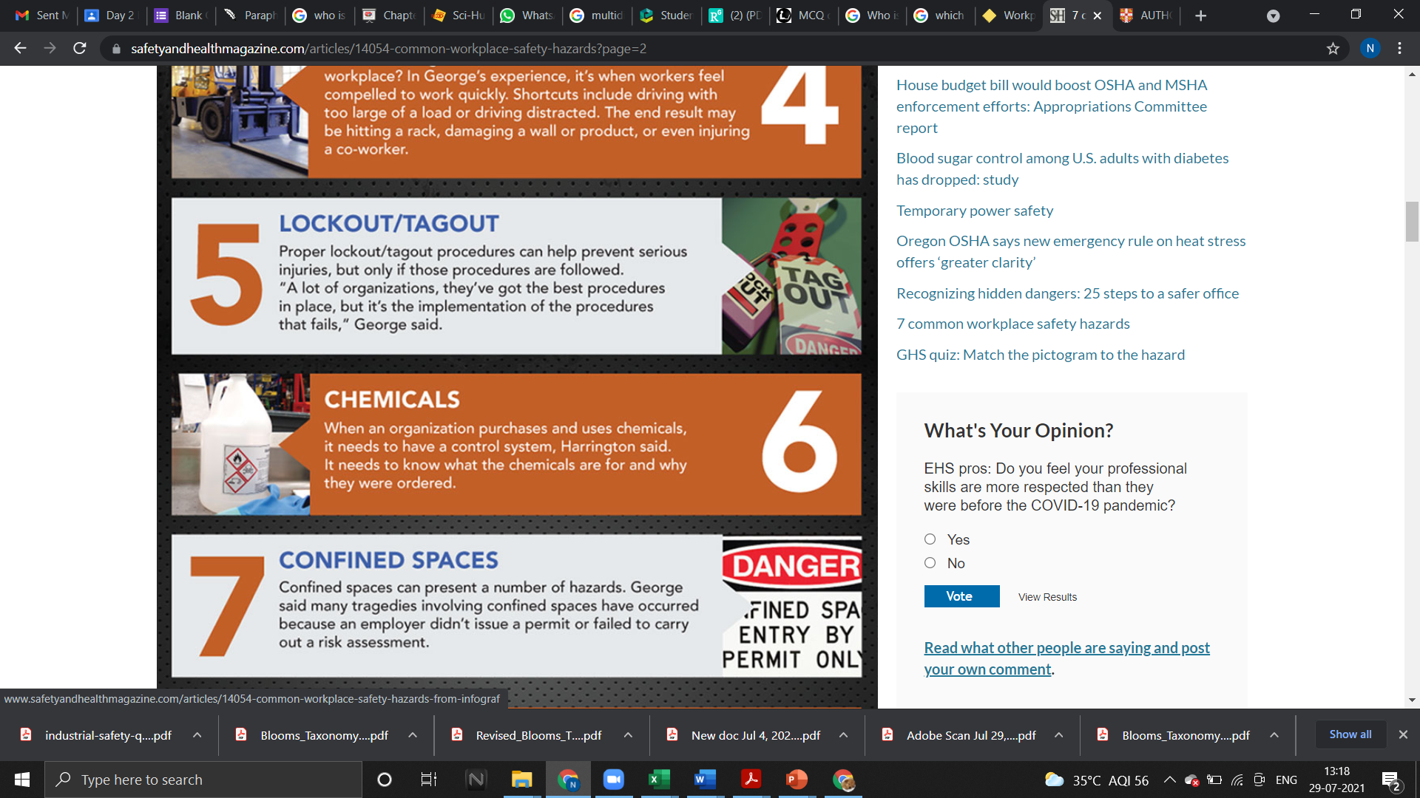
Seven common workplace hazards

